Slide 1
Lipid Digestion and Absorption

Slide 2
Quiz Question #1
What is the major cholesterol transporter in the small intestine
ABCG5
ABCG8
NPC1L1
SREBP2

Slide 3
Quiz Question #2
Which enzyme requires colipase for its activity?
Cholesterol esterase
Lingual lipase
Gastric lipase
Pancreatic lipase

Slide 4
Quiz Question #3
What tissue synthesizes chylomicrons
Liver cells
Bile ducts
Enterocytes
Adipocytes

Slide 5
Lipid Digestion and Absorption Learning Objectives
Identify the roles of lingual lipase, gastric lipase and pancreatic lipase including their locations and specific roles on lipid digestion in the stomach
Understand the role of bile salts in the formation of micelles, and explain how diseases of bile formation can affect an individual
Explain the transport mechanisms of lipids across the apical and basolateral membranes, and how they differ between lipid classes
Describe the re-esterification processes in the enterocyte
Explain the nature, formation and fate of the chylomicron and its role in lipid transportation

Slide 6
Midterm
Mean 71.4%
Median 74.2%
2017 midterm 1 mean 72%
33/51 A
41/51 got an A/A-

Slide 7
Next Steps
Look at GradePredictor
Contact Noura to make appointment if you want to review your exam
Ask us for help if things are unclear
Best predictor of success is coming to class well prepared

Slide 8
Desaturases and Double Bond Formation
SCD1
NOT IN HUMANS

Slide 9
ω3 and ω6 Fatty Acids are Essential in Humans
We have desaturates, but not any ω3 and ω6 desaturases
Because of this, we cannot convert 18:0 into 18:2ω6 or 18:3ω3
These PUFAs are required for several signaling lipids and must be obtained from the diet.
From plant sources
Linoleic acid (18:2 ω-6) Alpha-linolenic acid (18:3 ω-3)
From fish oils
EPA and DHA
FADS2
FADS1
Notes:
Formerly called vitamin F

Slide 10
Efficiency of ALA -> DHA/EPA Conversion
Generally we consume about 1g/day of LA (18:3ω3)
We consume <0.2g/day of EPA/DHA
Sex differences
women convert more efficiently
Genetic Differences (FADS1/FADS2)
African Ancestry, lower conversion
Hispanic, higher conversion
Direct supplementation of EPA/DHA may be more effective
http://lpi.oregonstate.edu/mic/other-nutrients/essential-fatty-acids

Slide 11
PUFA’s and Inflammatory Responses
Hormones that are derived largely from Arachidonic Acid (20:4ω6)
Leukotrines
Produced in White Blood cells, promote inflammation
Thromboxanes also known as Eicosanoids
Blood clotting
Prostaglandins
Vasodilation
Inflammation

Slide 12
ω3 Fatty Acids are either Anti-inflammatory or Resolving

Slide 13
ω3 and ω6 Fatty Acid Ratio
ω3 are thought to be metabolically beneficial
ω6 are essential but are generally over-consumed relative to ω3
In western diets can be 15:1
They compete with each other for enzymes, which is thought to be why too much ω6 can cause ω3 pseudo-deficiency

Slide 14
Questions to consider
Would saturated fats in the blood be good biomarkers of saturated fat intake?
Would blood w3 and w6 be good biomarkers of dietary intake?

Slide 15
Dietary Lipids
Triacylglycerols
Main lipid of diets
Provides essential FAs (polyunsaturated)
Average daily dietary intake:
Men: 95g
Women: 65g
Sterols (cholesterol) and phospholipids
Cholesterol average intake 300 mg/day (animal products)
1-2 g/day of phospholipids
NHANES 2000-2006

Slide 16
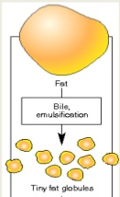
Lipids
Hydrophobic molecules -- challenge to travel through aqueous environments
Digestive mechanisms required to increases solubility of lipid particle
Mechanical forces - emulsification
Bile salts
Emulsification processes
Stability factor
Fat
Emulsification
Fat Globules

Slide 17
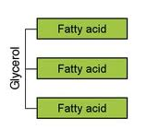
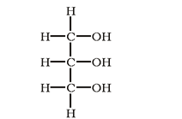
Triacylglycerol Digestion: Mouth and Stomach
Lingual lipase
Glands under tongue
Stimulated by neural factors, high fat diets, mechanical motion in mouth
Works in low pH (stomach), very little digestion occurring in mouth
Specific to:
MCFA on triacylglycerols
sn-3 of glycerol
Produces diacylglycerols and free FAs
sn-1
sn-2
sn-3
Glycerol

Slide 18
Gastric Lipase in the Stomach
Gastric lipase
Secreted by chief cells
Prefers SCFA/MCFA
Works best in low pH (stomach)
But can continue to work in upper small intestine
Specific to sn-1 and-3 of glycerol
Produces di- and monoacylglycerols and free FAs
sn-1
sn-2
sn-3

Slide 19
Triacylglycerol Digestion: Stomach
Emulsification – breaking large lipids into smaller lipids
Starts in stomach
Peristalsis
Wear and tear through sphincter
Fat
Emulsification
Fat Globules

Slide 20
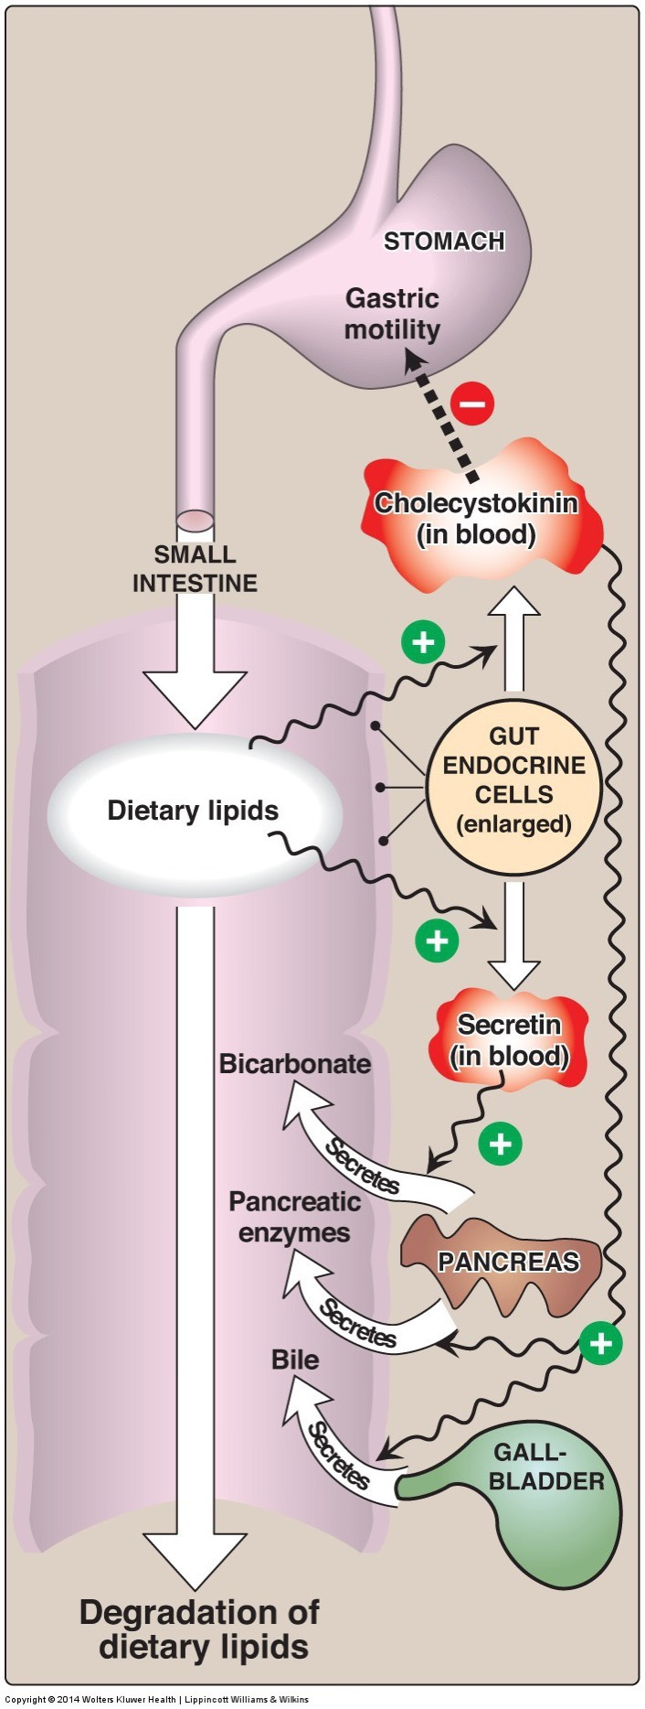
Triacylglycerol Digestion: Small Intestine
Lipid droplets and digestive products enter small intestine
90% of lipid digestion occurs in small intestine
Efficient emulsifiers – bile salts
Allows for greater availability of lipases to reach triacylglycerides
Different lipase (pancreatic lipase) – require less acidic environment

Slide 21
Triacylglycerol Digestion: Role of CCK
CCK activated by peptides and fats in the small intestine and released from enteroendocrine cells (I Cells)
Also stimulated by paracrine signaling from enterocytes and the parasymathetic nervous system
CCK stimulates release of:
Bicarbonate and lipases from pancreas – part of pancreatic juice
Bile from gallbladder
Notes:
Parasympathetic (rest and digest or feed and breed)

Slide 22
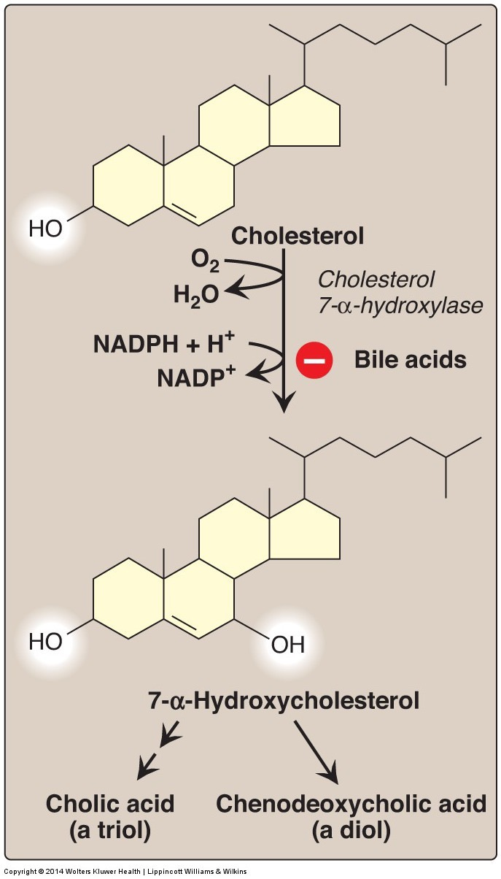
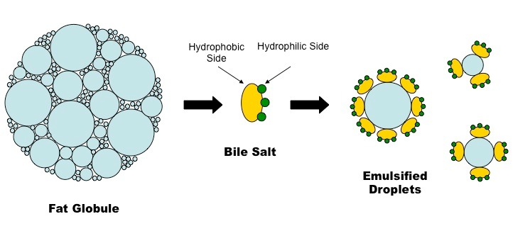
Bile Acid Production
Notes:
Conjugated with taurine

Slide 23
Bile Salts and Intrahepatic Portal Circulation
Cholesterol is converted into bile salts and stored in gall bladder
CCK promotes Bile Release
Contraction of gallbladder
Relaxation of Sphincter of Oddi
~30g per day released per day, 95% of it is recovered in terminal illeum
Shphincter of Oddi

Slide 24
What kind of transport mechanism do you think is needed to fill the gall bladder?
Diffusion
Active Transport
Passive Transport

Slide 25
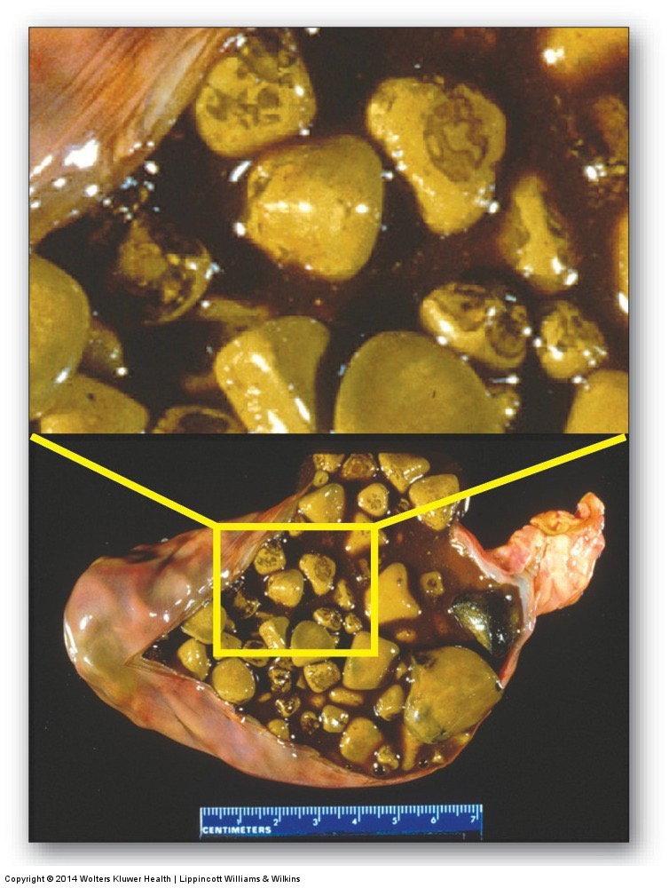
Other problems due to bile salt defects
Cholestasis
Reduced flow of bile
Caused by hepatitis, liver disease, biliary cirrhosis, bile stones or blockages
Poor absorption of fats, vitamins (D/E/K)
Gallstones
Crystalization of bile salts in gallbladder
Associated with too much cholesterol in diet
Cholecystis
Inflammation of gallbladder
Commonly caused by gallstones

Slide 26
Treatment Options for Bile Salt Disorders
Exogenous bile salt supplementation
Low fat diet
Medium chain triglycerides
Oral fat soluble vitamins (A, D, E, and K)

Slide 27
Triacylglycerol Digestion: Small Intestine
Pancreatic lipase activity
–Specific to sn-1 and -3 FA of triacylglycerol
- LCFA
Products include:
Di- and monoacylglycerols (sn2)
Free fatty acids
sn-1
sn-2
sn-3

Slide 28
Pancreatic Lipase Requires Colipase
Pro-colipase secreted by pancreas
Activated by trypsin to colipase (co-enzyme for pancreatic lipase) in small intestine
Colipase required for pancreatic lipase to recognize and bind substrates
Colipase allows pancreatic lipase to bind to lipid droplet = hydrolytic action on droplet
Lipase or Colipase deficiency – results in lipid malabsorption

Slide 29
Orlistat (aka Xenical)
Jarl S, Mark N. XENical in the Prevention of Diabetes in Obese Subjects ( XENDOS ) Study. Diabetes Care 2004; 27:155–61.
What would be some side effects of xenical?
Notes:
4-6lb in other studies.
Steatorrhea
Contraindications for malabsorbtion, reduced gallbladder function and pancreatic diseases

Slide 30
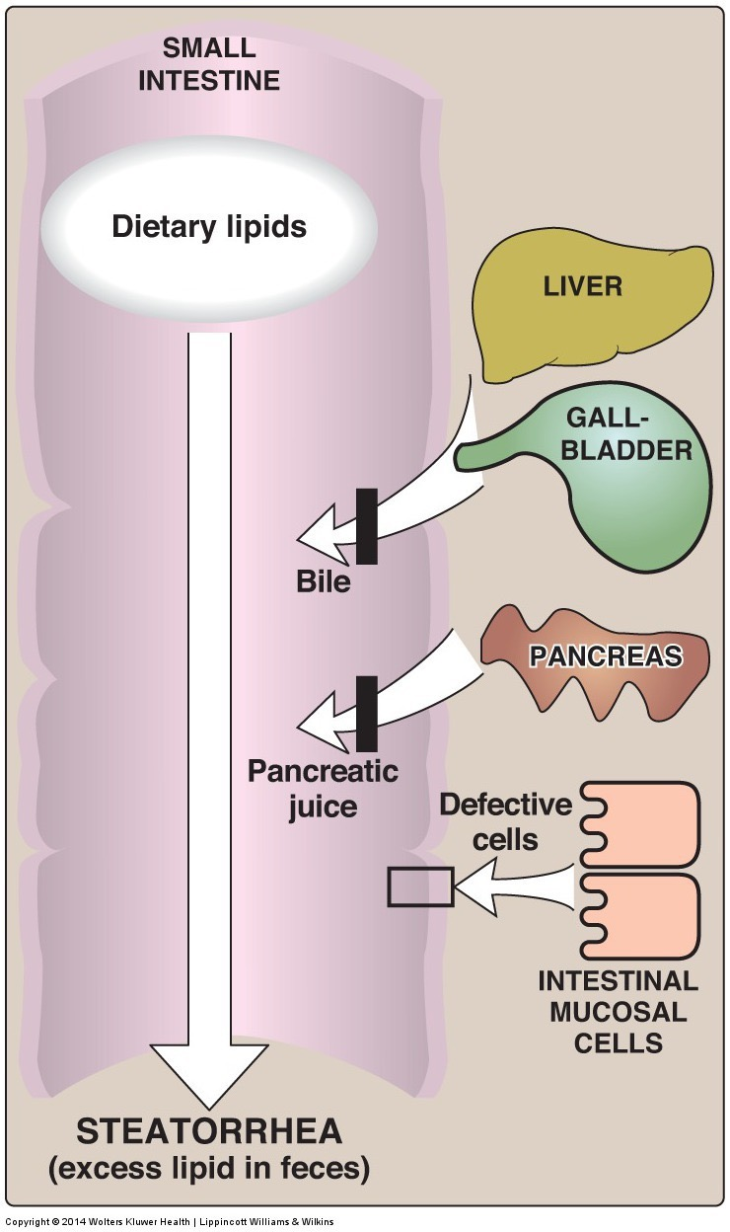
Steatorrhea
Excess fat intake
Decreased digestion
Decreased absorption
Can be caused by inflammation reducing the efficiency of digestion and absorption
Celiac, Crohn’s disease

Slide 31
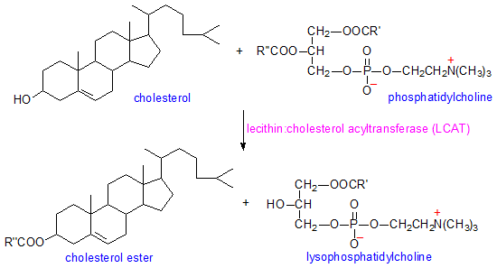
Cholesterol Digestion
Sterol esterase: cleaves fatty acid from cholesterol ester
In small intestine, secreted from pancreas in active form
Esterase
Esterified cholesterol
Cholesterol + Free FA
Fatty acid

Slide 32
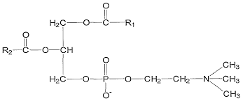
Phospholipid Digestion
Pancreatic phospholipase secreted from pancreas
Phospholipase A2 specific to sn-2 of phosphatidylcholine
Most predominate dietary phospholipid is phosphatidylcholine
Phospholipase A2
Phosphatidylcholine
lysophosphatidylcholine + Free FAs
Fatty acid
Fatty acid

Slide 33
Lipase Worksheet
Lipase | Where Secreted | Where Active | Specificity (type, sn and length)
Lingual
Gastric
Pancreatic
Cholesterol Esterase
Phospholipase A

Slide 34
Which lipase would be least affected by antacids?
Lingual Lipase
Gastric Lipase
Pancreatic Lipase
Notes:
C

Slide 35
Lipase Worksheet
Lipase | Secreted | Where Active | Specificity (sn and length)
Lingual | Mouth | Stomach (pH) | sn3 MCFA/SCFA
Gastric | Stomach (Chief Cells) | Stomach (pH) and SI | sn1/sn3 MCFA/SCFA
Pancreatic | Pancreas (CCK) | SI | sn1/sn3 LCFA Requires colipase
Cholesterol esterase | Pancreas (CCK) | SI | Cholesterol esters
Phospholipase A2 | Pancreas (CCK) | SI | Phospholipids (sn2)

Slide 36
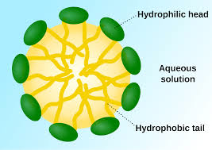
Small Intestine End Products
Products in small intestine:
Fatty acids
Mono- and diacylglycerols
Cholesterol
Phospholipids
Micelle Formation
Micelle

Slide 37
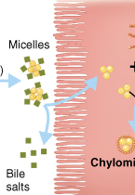
Absorption: Small Intestinal Enterocytes
Lipid contents diffuse out of micelle
Cross apical membrane by diffusion (concentration gradient), passive and active transport mechanisms
Bile salts are either exported from enterocyte or removed during uptake

Slide 38
What happens in the enterocyte?

Slide 39
Plant Sterols, ABCG5/8 and Sitosterolemia
Plant sterols compete with cholesterol for transporter (NPC1L1)
May be cholesterol lowering agents
Normally removal of plant sterols from the small intestine is is very efficient (~95%) by ABCG58 Active Transporters
Lack of ABCG5/8 leads to build up of phytosterols in the body which cannot be exported as bile salts this is sitosterolemia
Notes:
1:50 000

Slide 40
SREBP2 and Regulation of Cholesterol Uptake

Slide 41
Absorption: Small Intestine
Digested lipids in enterocyte
FAs with <12 carbons are more soluble
Diffuse into circulation → liver
Transported to liver by albumin
Small and medium chain fatty acids
FA with ≥12 carbons reform (re-esterification) into:
Tri, di-, and monoacylglycerols
Cholesterol esters

Slide 42
Chylomicrons are lipoprotein particles
Re-esterfied lipids and long-chained fatty acids form a chylomicron
Transporter of re-esterfied lipids and long-chained fatty acids out of small intestine
Chylomicron gains a protein and phospholipid coat for solubility – thus considered to be a lipoprotein

Slide 43
Apolipoproteins
Apolipoprotein: protein that stabilize lipid particle in aqueous environments
Named by apo + series of letters (A-E) + number
Examples: apoB-100, apoE, apoB-48, etc.
Apolipoproteins have other physiological functions important for lipid metabolism:
Stimulate enzymatic reactions
Regulate metabolic functions such as lipase activity
Specificity towards receptors, targets lipoproteins to particular tissues
LDL contains apo100
apo100 specific to the LDL Receptor (LDLR)

Slide 44
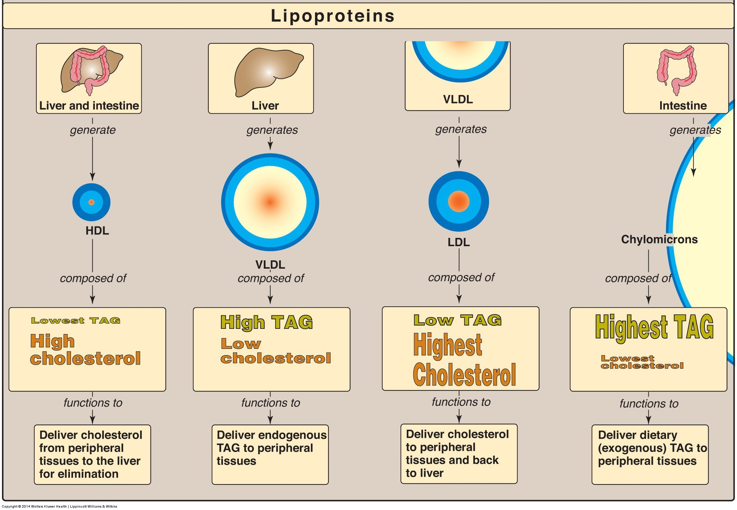
Other Lipoprotein Particles

Slide 45
Role of Apolipoproteins and LDL in Triglyceride Transport
Specific apolipoproteins in chylomicrons are ApoA1 and ApoB48 these are added in the enterocyte
They pick up ApoCII/E in circulation
Reiner Ž. Hypertriglyceridaemia and risk of coronary artery disease. Nat Rev Cardiol; 2017; 14: 401–11. doi: 10.1038/nrcardio.2017.31.

Slide 46
Chylomicron – Lipid Transportation
Chylomicrons too large to enter capillaries
Exits basolateral membrane into lymphatic circulation
Exocytosed through basolateral membrane via secretory vesicle
Chylomicron bypass liver and enter circulation via lymph system

Slide 47
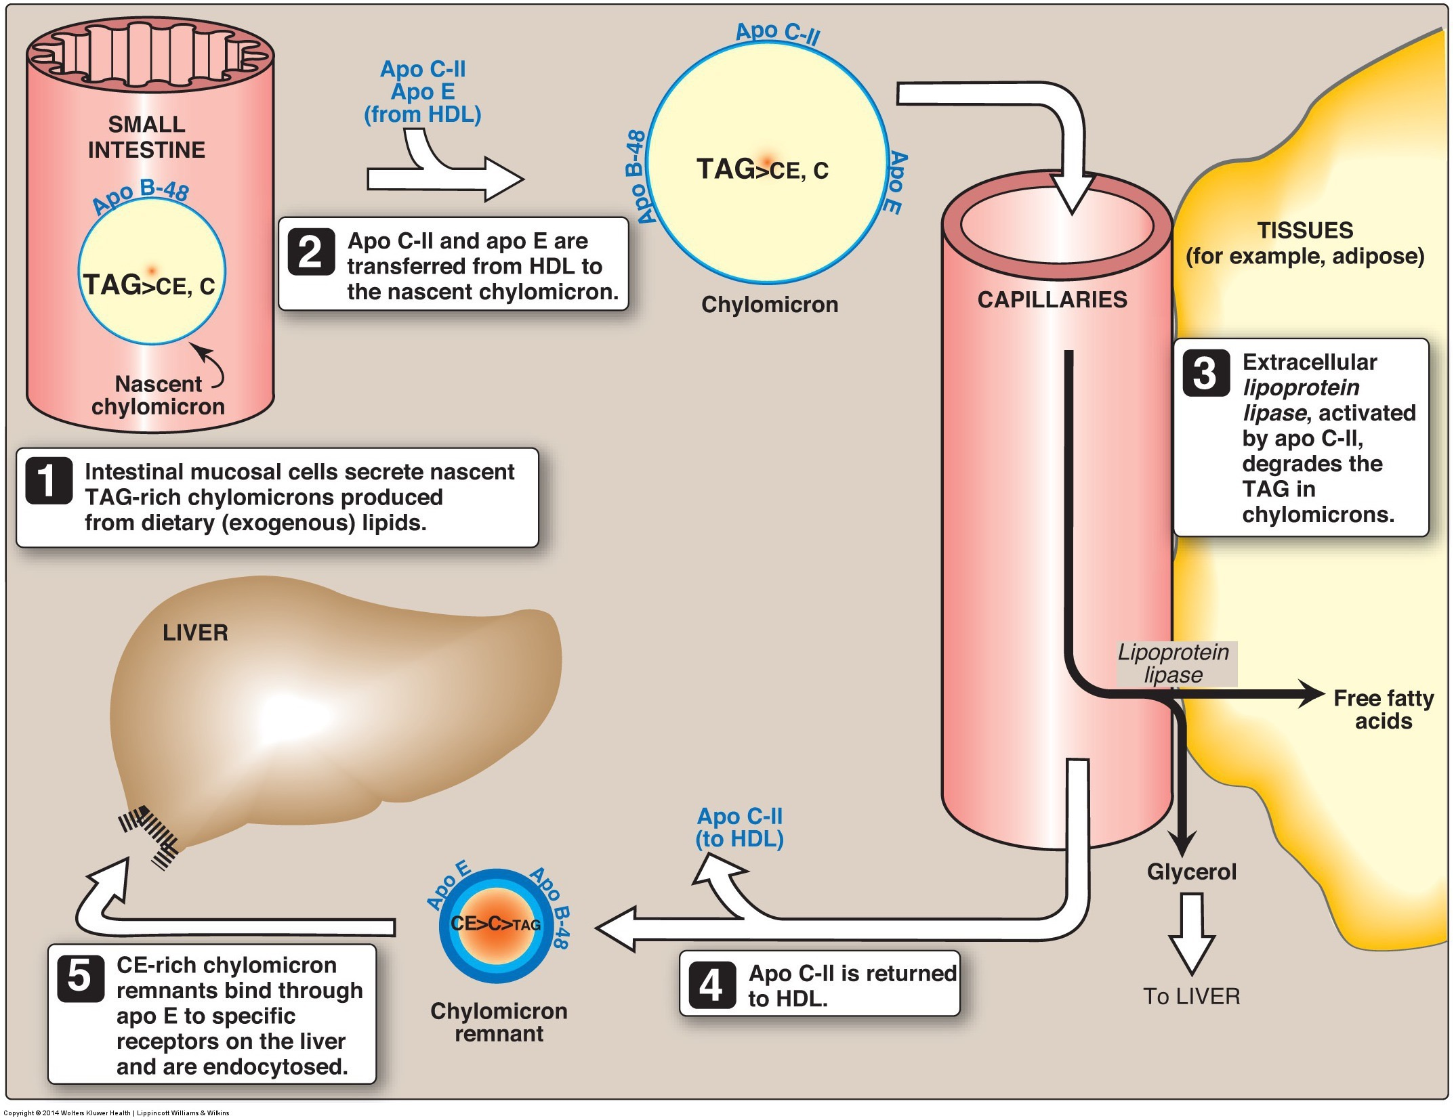
Chylomicrons Transport Lipids to Tissues
Chylomicrons travel mainly to adipose tissue and muscle
Lipoprotein lipase (LPL) – enzyme in endothelial membrane of adipose and muscle tissues
Chylomicron remnant travels to liver
Notes:
ApoC helps LPL recognize lipids
Hydrolyzes FA from mono-, di-, and triacylglycerols of chylomicron
Fatty acids enter tissues
Product of lipoprotein lipase: Chylomicron remnant – rich in cholesterol

Slide 48
Chylomicron Retention Disease
Mutations in the SAR1A gene, means that chylomicrons cannot be exocytosed from the enterocyte
What symptoms would you predict?
What dietary treatments would you suggest?
Notes:
Absorption of fats, vitamins and cholesterol, steatoherrea

Slide 49
Chylomicron Retention Disease
Symptoms
Treatments
Failure to thrive
Vitamin A/E/K deficiency
Steatorrhea
Biopsy/endoscopy shows Lipid laden villi
Low fat diet but high in essential fatty acids
MCFA
Encapsulated vitamins or IV fat soluble vitamin injections

Slide 50
Summary
Lipases are enzymes that work to breakdown large lipids to smaller lipids
Lingual/gastric (low pH to function) and pancreatic (higher pH to function) lipase
Lipases, bile, and mechanical forces efficiently emulsify lipids
Micelles made of digested lipids and bile salts form at the brush border
Aides in successful absorption across apical membrane of enterocyte by stabilizing in aqueous environment
Digested lipids (>10 FA HC chain) are re-esterfied in enterocyte
Digested lipids form chylomicron - contains apolipoproteins and phospholipids – before being absorbed across basolateral membrane
Enter lymph system
Transportation of chylomicron results in chylomicron remnant which is cholesterol rich
Chylomicron remnant continues transporting cholesterol to tissue
Eventual formation of IDL, LDL, and HDL

